Slide 1

‘This music crept by me upon the waters’: The Effect of Economic Activity on Listening Habits
M. Eymen Akın

Slide 2

Research Question & Motivation
Our music habits are heavily affected by our moods.
They exhibit strong co-movement!
Also, economic circumstances affect our moods deeply.
So, how does economic activity affect our listening habits?
Motto
In the dark times,
Will there also be singing?
Yes, there will be singing,
About the dark times.
-Bertolt Brecht
Data
Spotify analyzes the audio features of each track!
Also includes ‘valence scores’, a measure of positivity.
‘top-charts.com’ gathers weekly Top 100 songs for 40+ countries.
OECD has a weekly GDP tracker for 40+ countries.
Methodology
1. Scrape top-charts.com, obtain each available list (3.7k+).
2. Plug each song in each list to Spotify API & get valence scores.
3. Combine with OECD weekly tracker GDP data.
4. Panel Data Regression

Slide 3
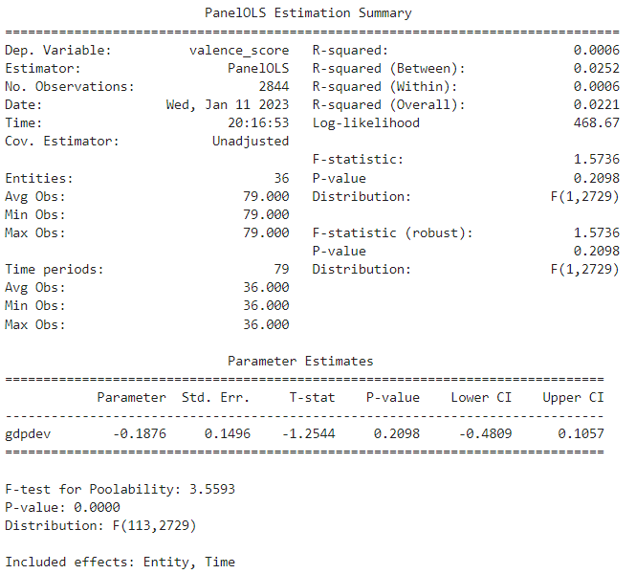
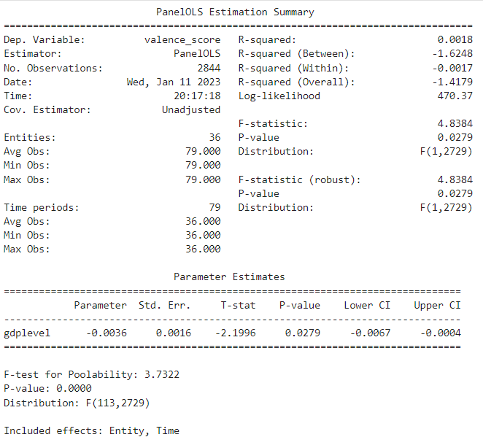
Preliminary Results
Figure 1 – Log Deviation in Weekly GDP
Figure 2 – Weekly GDP Tracker Level (rel. to 2019 Q4)

Slide 4
Limitations, Concerns, Areas of Improvement
Endogeneity
Bane of all macro-level studies.
Omitted Variables
Literally no covariates, for now.
Frequency mismatch
Who among us is affected by weekly domestic production?
Mostly Western Countries
Shackled by the data or lack thereof.
Sample Size
See the point above.
Idiosyncratic period
Late-2019 to mid-2021. Who was feeling well at the time?

Slide 5
The End

